Slide 1
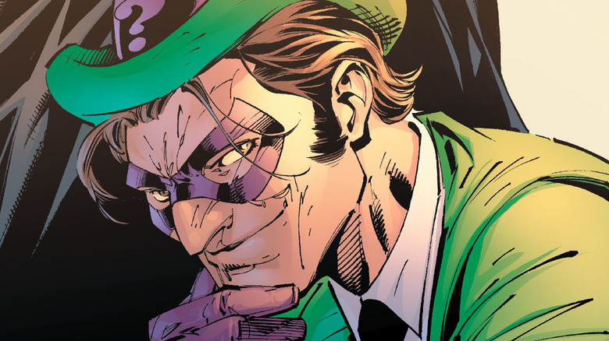
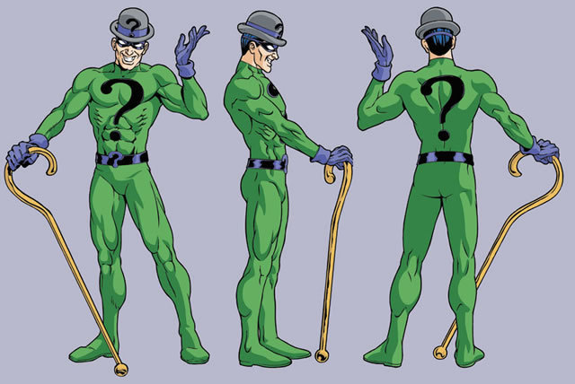
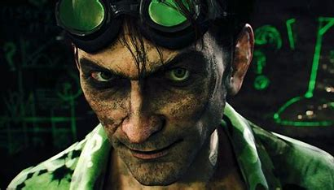
The Riddler
By: Sarah Monarca, Morgan Rault, Nick Piscitelli

Slide 2
Outline
How project works
Future plans/Learned
Goals and Objectives
What we accomplished
Relevance

Slide 3

Overall Goals
Overall goal we set for our project was to help Batman defeat the Riddler
We wanted to be able to use 3 sensors mixed in with complex riddles for the user to solve.
We wanted to implement pop ups (GUI components) because we found that was the easiest layout for users to visualize and play along with the game.

Slide 4
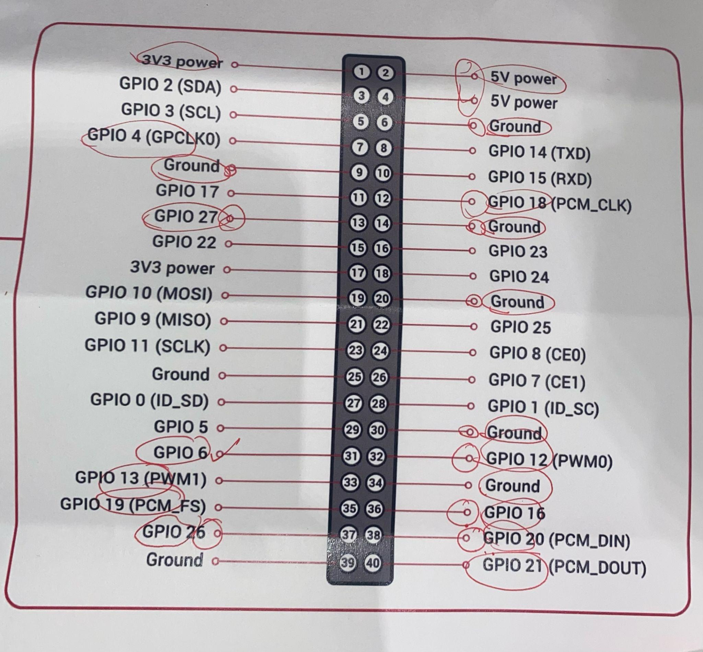
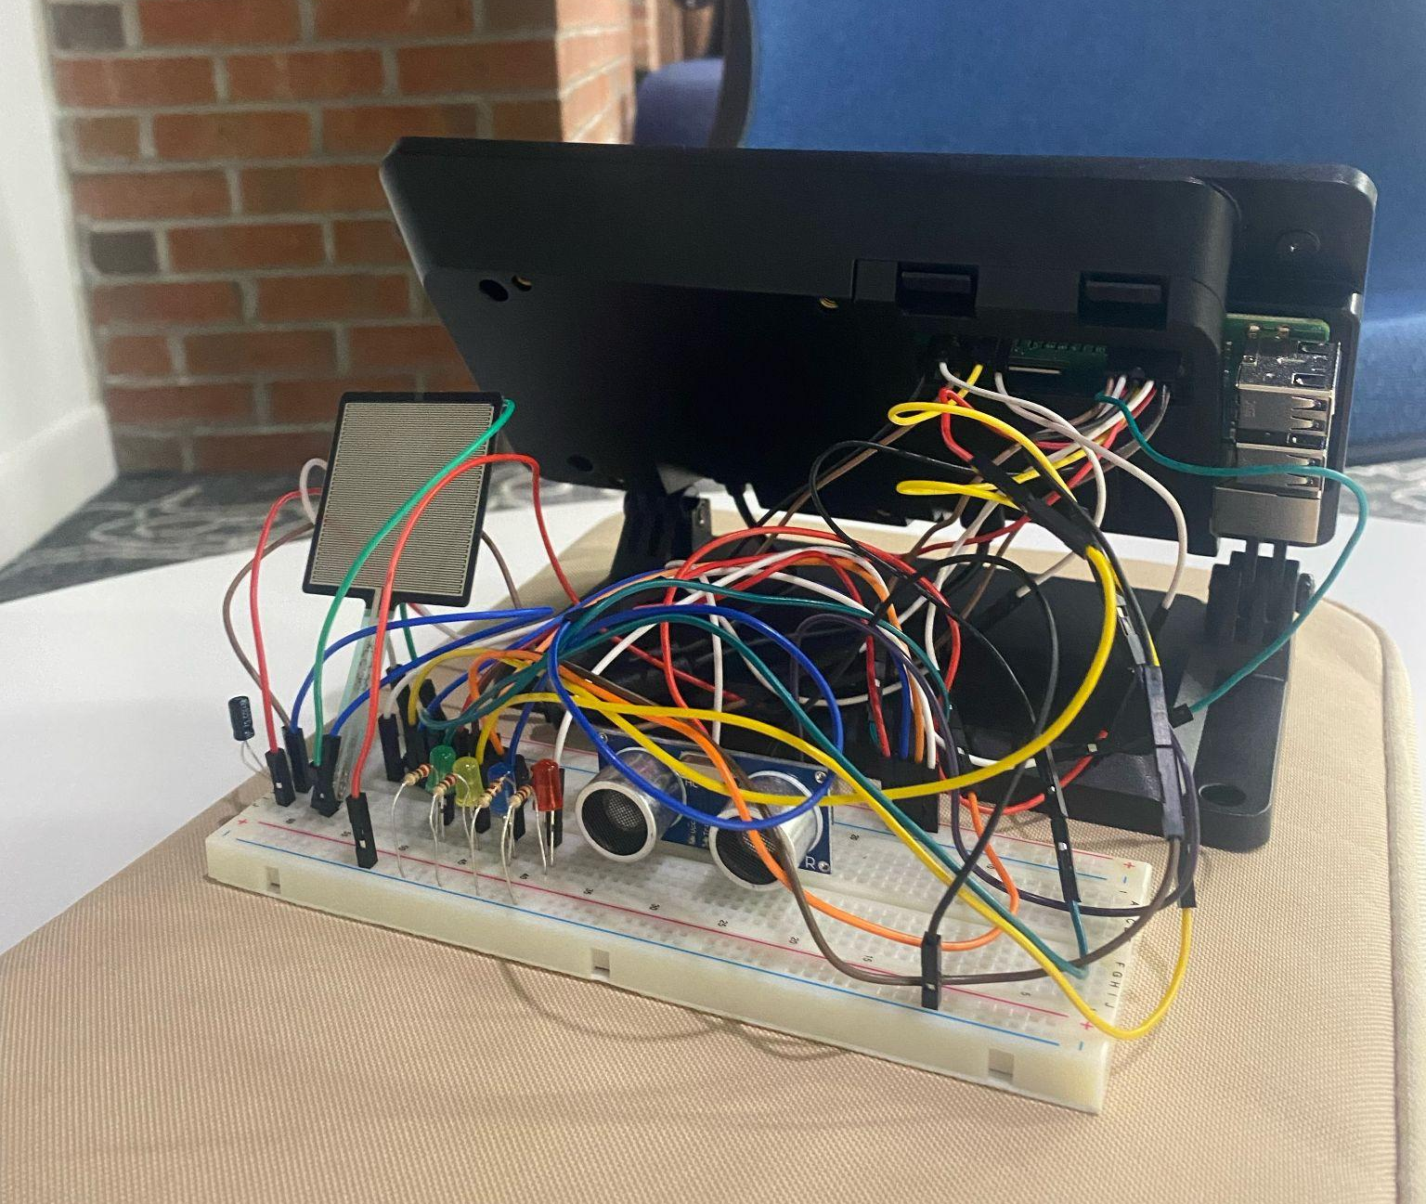
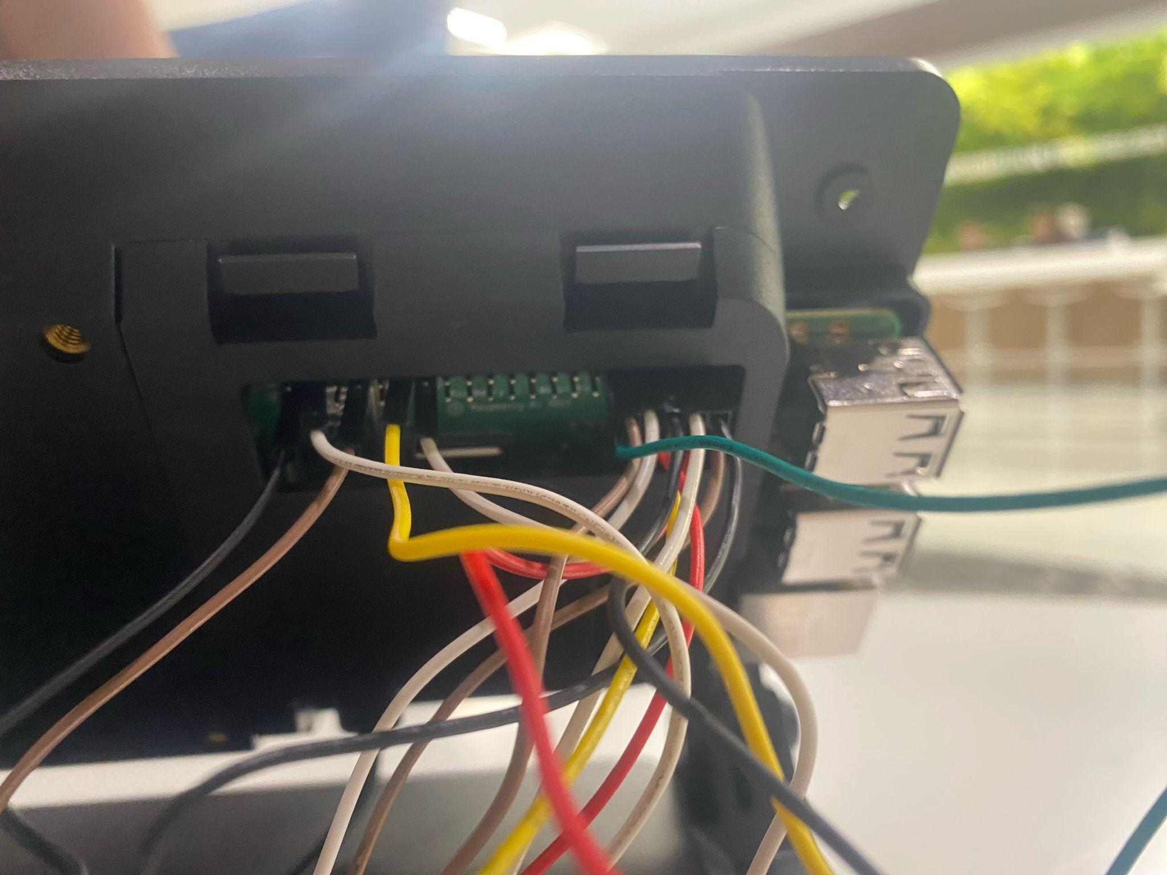
What we accomplished
We were able to fit all three of our sensors onto one breadboard by connecting our pins directly to the circuit.
Also successful in implementing GUI pop ups with pictures as well as descriptions for the user to follow.

Slide 5

How it works
Riddle #1
Pressure Sensor
Riddle #2
Adaptive Simon Game
Riddle #3
Distance Sensor
Riddle #4 - GUESSING GAME
Room Game
From Start to Finish:

Slide 6

Relevance:
We built off of multiple programs from class in order to make our final project.
We created our own personalized GUI components after learning the details of graphical user interface in class.
Future Plans/ Learned:
We learned how to put pins directly into the circuit incase we were missing pins on the breadboard itself or it required special pins.
We were able to implement the use of a new sensor (pressure sensor) that was not provided in previous classes.
We also learned a lot about classes and while loops through our coding.

Slide 7


